Slide 1

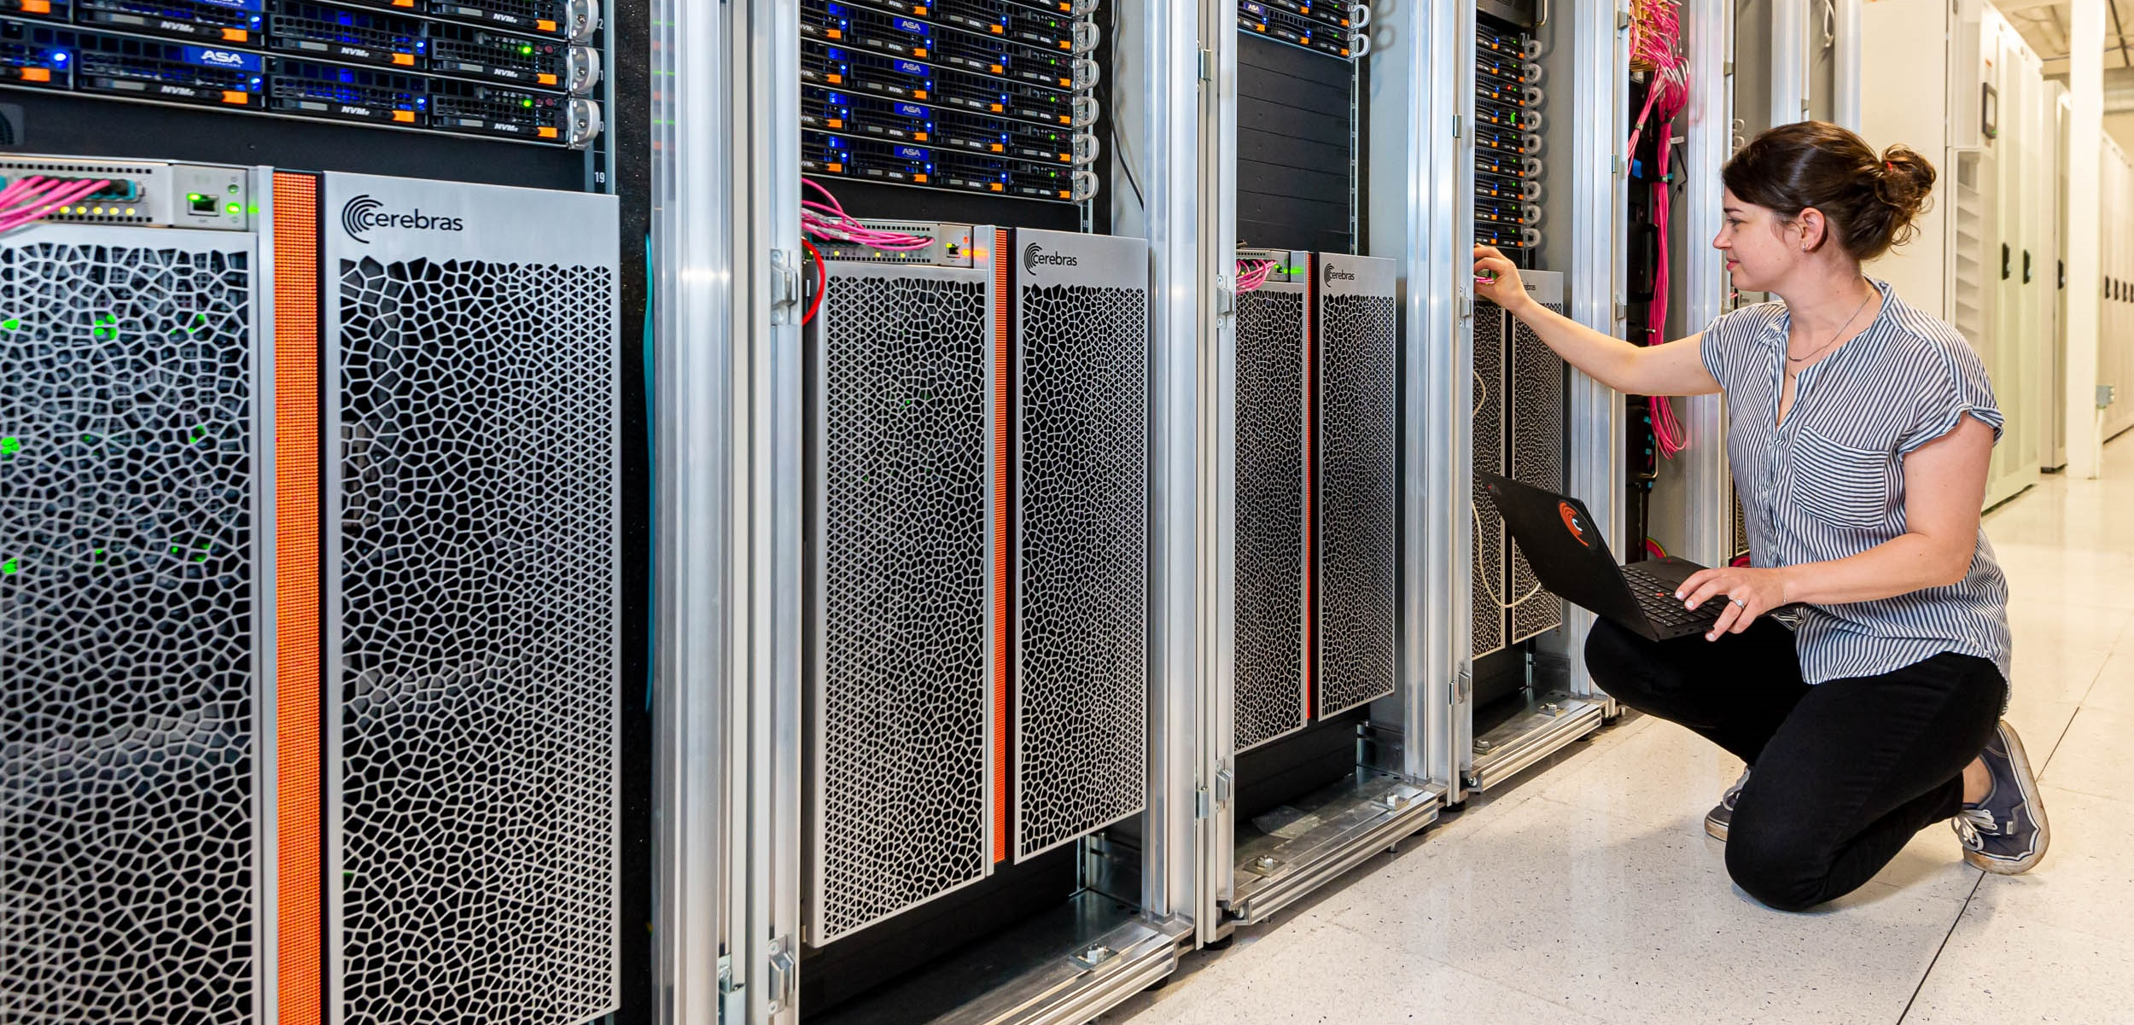



Accessing the CS-2

Slide 2
Everyone has a visitor account
We will come round now and provide everyone with their own visitor account on the EPCC host system (connected to two CS-2s)
You can then use Putty (on Windows) or your inbuilt SSH client (on Linux or MacOS) to SSH into the remote machine

Slide 3
Let’s access the machine
Step one – using the visitor account assigned to you, login to our CS-2 host machine
ssh vistor01@sdf-cs1.epcc.ed.ac.uk
We are now logged into the host machine that connects to the CS-2
Step two – clone the tutorial repository
git clone https://github.com/EPCCed/cs2-sdk-training.git
Step three – cd into the cs2-sdk-training/practicals/walk-through which we will be working in for the next part of the tutorial
[vistor01@sdf-cs1 ~]$ cd cs2-sdk-training/practicals/walk-through
[vistor01@sdf-cs1 walk-through]$ ls
wt1-getting-started wt2-basic-syntax wt3-memcpy wt4-memoryDSDs
wt5-multiple-PEs wt6-routes-fabricDSDs wt7-collective-communications
Let one of the tutors know if you are struggling with this

